Slide 1

DATA SCIENCE IMMERSIVE Using R in Kaggle Competitions
29th September 2017
Garrett Teoh Hor Keong
Notes:
Thank everyone for making your way down here and spending your precious evening for this session/sharing, although,
It is near to festive season and it is my great pleasure to see so many of you who has a burning passion for data science and thirst for knowledge.
At the end of this session, I hope everyone here can gain some knowledge and bring it back to apply it in your daily work or for those who are keen to step into Kaggle can get a decent ranking from using the techniques share in this session.
If you have any questions to raise during the presentation, please do not hesitate to stop me and ask.
Can I do a background sensing on the expertise level of the audience so that I can adjust my pace as accordingly.

Slide 2
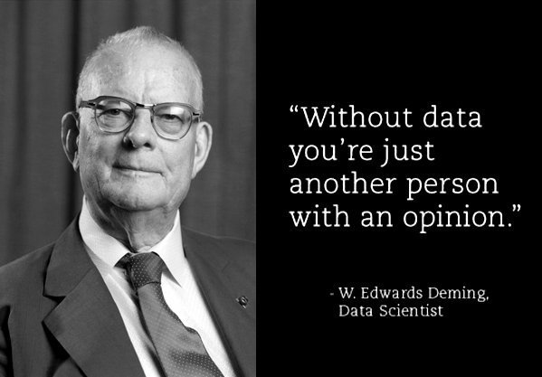
Notes:
This quote places a heavy emphasis and highlighting the critical importance of data in which how a person can use data to support their decision making process.
Supposedly if you receive news from the HR dept. saying one of your salesperson is going to resign next month and you urgently need to hire a replacement, else the team performance is going to suffer, would you believe it? Now that’s a bad news isn’t it? And the natural reaction for anyone would be to ask the HR for more info to support their claim.
Conversely, if the CFO is telling you that your company is operating in its optimised form, OPEX are minimised while expecting a healthy stream of revenue coming in.
Without data to back what you are claiming, there’s no credibility to the claims.
Data is essential to prove everything. In the realm of data & insights, there are 4 approaches in which how to squeeze juice out from data
Data can be measure in 2 ways (although there are always the 4Vs or 5Vs), main classification – volume, variety (aka complexity)

Slide 3
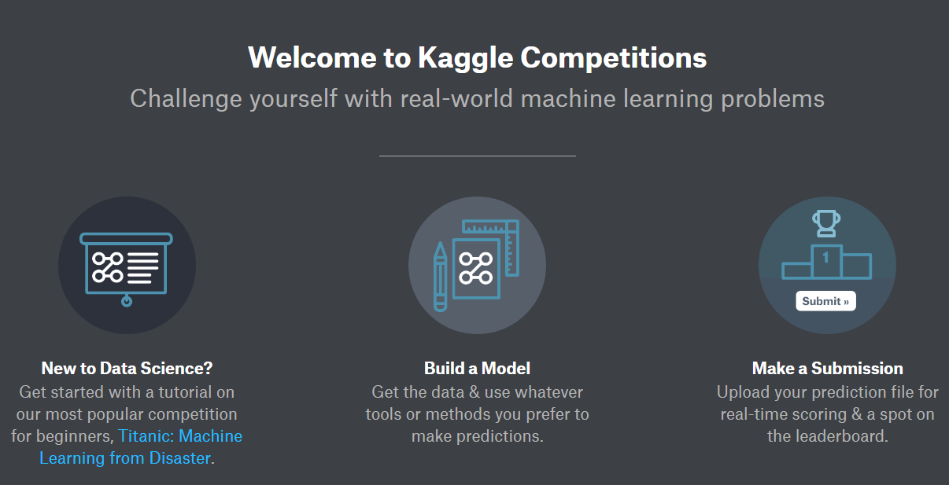
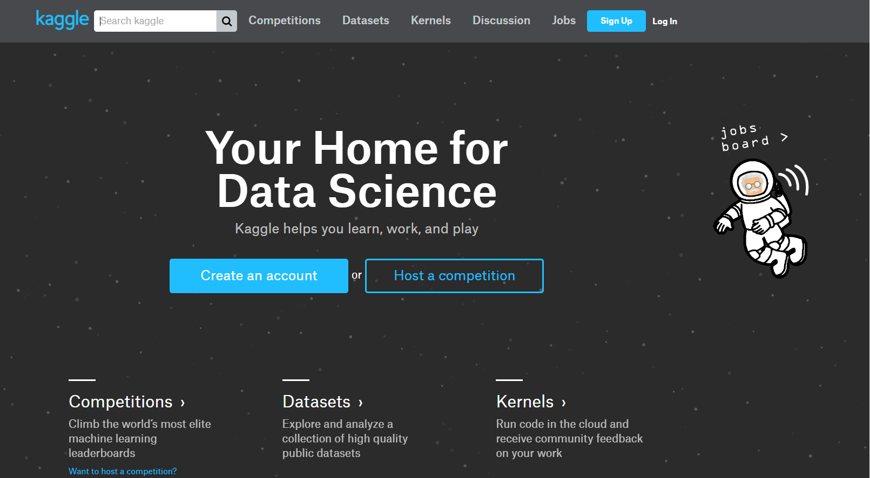
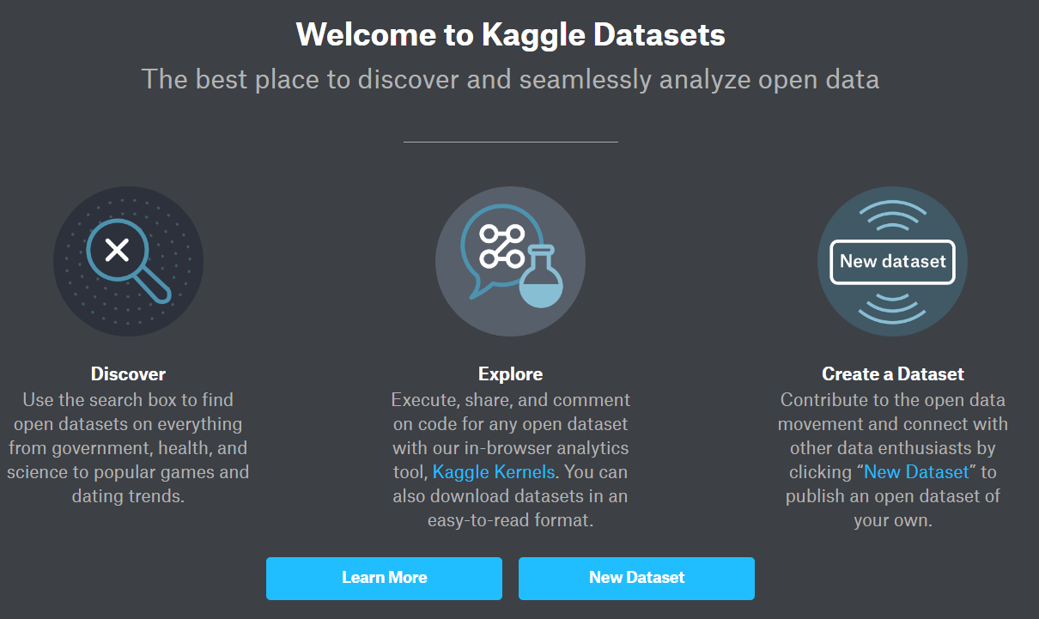
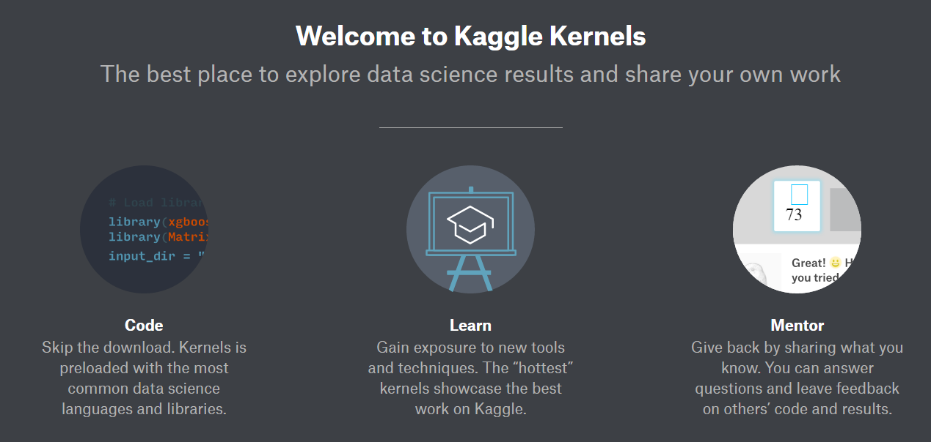
What is Kaggle?
Learn, Explore, Compete, Have Fun
Notes:
Home for Data Science, A Playground all data scientists/aspiring to become 1, to Learn, Experiment, and/or Compete.
Datasets (1st step)
Find new datasets from different industries
Explore (in depth) what are the features in this data set and how they are correlated? (Exploratory Data Analysis), share comments and findings with other DS.
Create your own dataset and upload it for other DS to explore and comment/gather feedbacks and insights.
Kernels (2nd step)
Download sample scripts and run on their kernels (Jupyter Notebook alike)
No need to download their datasets, skip the process
Learn from others regarding latest trends in algorithms or coach others by sharing your knowledge and providing feedbacks.
Competitions (3rd step)
Build your models and put it to a test with top notched DS worldwide.
Compete for prizes (attractive!)
Job postings, and discussions etc…

Slide 4
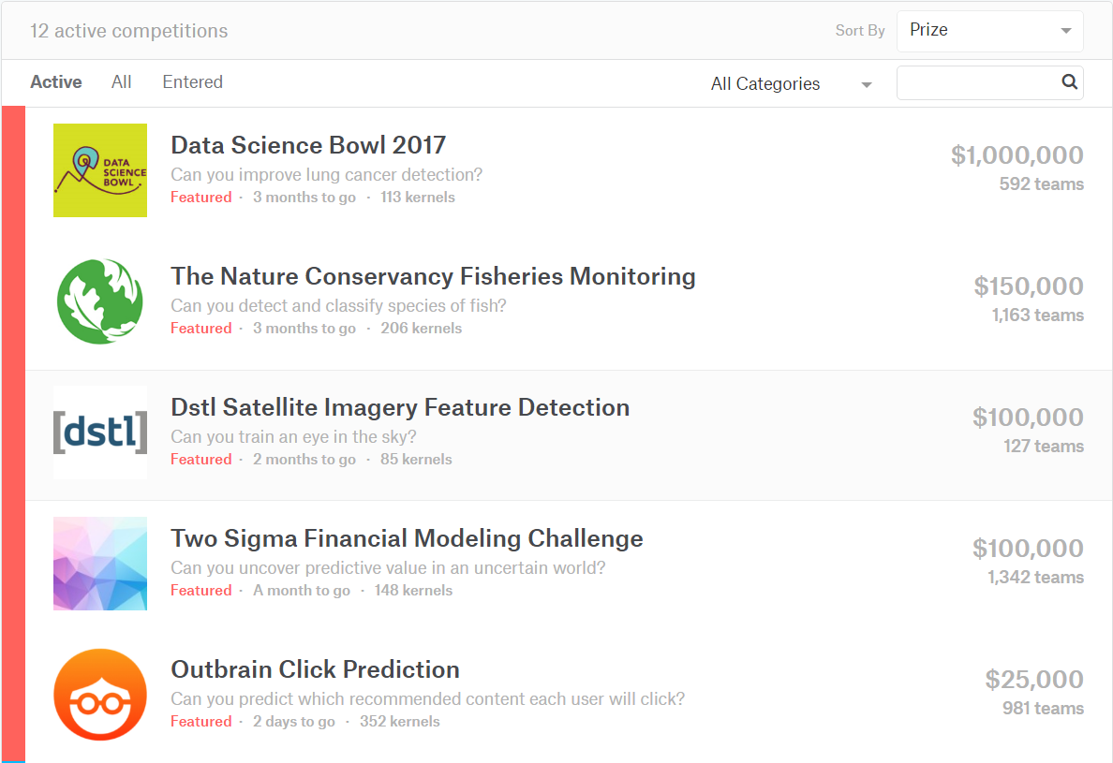
Which Competition to Participate?
Featured
Competitive
(Count towards rank)
Recruitment
Competitive Solo (Count towards rank)
Playground
Non Competitive (Does not count towards rank)

Slide 5
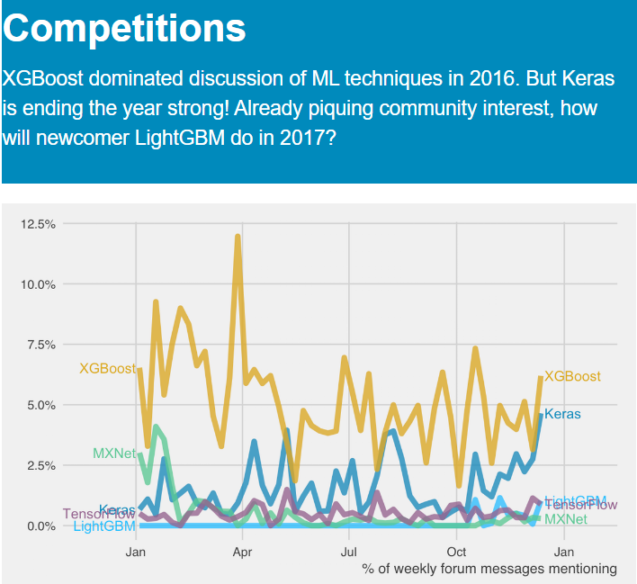

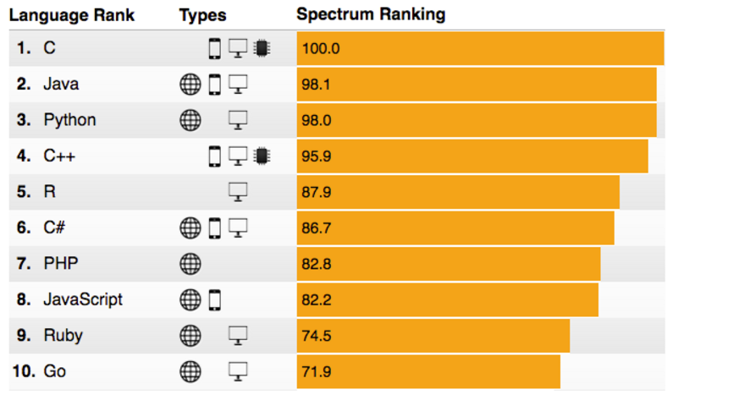
http://www.datasciencecentral.com/profiles/blogs/r-moves-up-to-5th-place-in-ieee-language-rankings
Why use eXtreme Gradient BOOSTing & R?
Notes:
Varies accordingly to the nature of the competitions (which ML is more suited? Predicting binary/multiclass vs classifying images)
IEEE Spectrum ranks languages according to a large number of factors, including search rankings and trends, social media mentions, and job posting.
R moved up from the 6th position to 5th this year.
R by contrast is a language specifically for data science, and its high ranking here reflects both the critical importance of data science as a discipline today, and of R as the language of choice for data scientists.
The other four languages in the top 5 (C, Java, Python amd C++) are all general-purpose languages, suitable for just about any programming task.

Slide 6
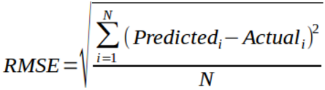
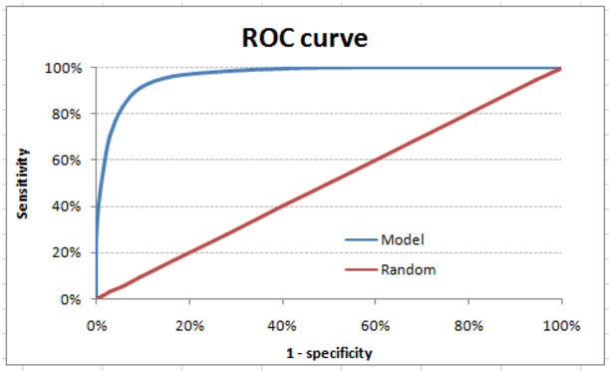

Choosing a Competition
Objective – Binary/Multi-Class Classifications, Continuous Value predictions, Image Classifications, Recommendation, Optimization.
Evaluation – AUC, LogLoss, RMSE, Mean Absolute Error (MAE), Mean Average Precision @n (MAP@n)
Size of Datasets – Train/Test proportion, n Samples, n Dimensions.
Team/Solo/Prize/Timeline/Kernel….
Notes:
Let’s say now that you are ready to compete (skip all the good experimentation/learning part and get things going, in fact doing the competition itself is part of the learning and gaining experience, don’t feel shy about starting a competition):
My first 2 or 3 Kaggle competition ranking wasn’t good.
Few considerations when choosing a competition
Considering the objective: different objective requires to deploy different ML models. Determine the objective that you are good at.
3 main classes of analytics:
Predictions (supervised) e.g. predict churn rate, portfolio performance, conversion rate, type of failure.
Recommendations (unsupervised) e.g. new product launch, recommend, video/hotel stay packages recommendations
Optimizations e.g. Traffic congestions, investment portfolio strategies (fluctuations in buy, sell, dividends and etc)
Evaluations
AUC, only used on binary predictions, LogLoss can be used for multi-class/binary classifications. MAE, RMSE typically used for continuous or binary predictions
MAP@n used for recommendations algorithms evaluations
Optimizations are just measure of the direct output. Revenue or Time
Your computer/PC will determine what dataset size is suitable to run your analysis. E.g. Springleaf dataset is 1 million samples with 1k plus features.

Slide 7
Starting a Competition
Downloading datasets – Train, Test, and Submission.
Matching sample IDs in test.csv -> IDs in submission.csv
Timeline – First submission, Merger (teams), Final submission.
Rules – No sharing of information between teams, no public datasets, one account per competitor, daily submission limit of 5. *Take note for team forming criteria: Total Subs <= (Days competition running * 5)
Public & Private LB – Only public scoring will be shown, private scores will be revealed at the end of the competition.
Notes:
Always check the dataset, train, test and sample submissions.
Check for the timeline, important of you are going to form a team for the competition. Usually competes as a solo competitor and merge/form teams before merger deadline.
Understand Public & Private LB
Always check for the rules before starting, plan well.

Slide 8
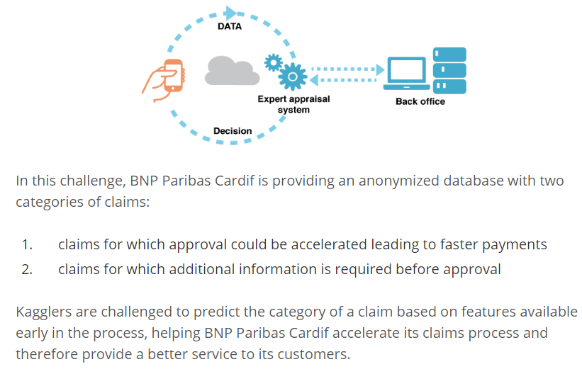
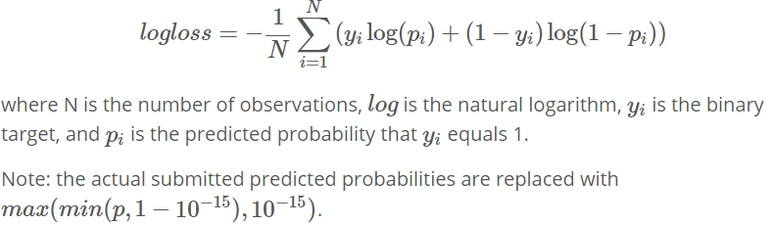
BNP Paribas Challenge Example
Objective (Problem Statement)
Evaluation metric: Logloss
Datasets: Train (114321), Test (114393), 131 features
2,926 teams participated, prize money: $30,000, timeline: 3 months

Slide 9
R Code: Essential Packages
READR - for reading in input files and writing output submission files in .csv
01
XGBOOST - machine learning algorithm, trees or linear regression based booster
02
CARET - data splitting and pre-processing. model tuning and feature selections
03
MLMETRICS - collection of various evaluation metrics.
04
BINR - cutting numerical values into evenly distributed groups (bins), for basic features engineering
05
DPLYR - handy tools for data manipulations e.g. n_distinct, arrange, filter and etc.
06
GGPLOT2 - the famed R elegant data visualization tools for bar charts, line graphs, histograms and more…
07
Notes:
READR
Read.table (more options skip lines, read from all kinds of files, sep can be defined)
Fread, openxlsx are also good alternatives
XGBOOST
Machine learning method, highly customizable, lots of prebuilt standard DS tools.
CARET
Mainly used for nearZeroVar analysis in my script. Although it can do many other sutffs like cross validations, model selection, and feature selections, hyperparameters tuning and etc…
MLMETRICS
Contains the most useful utility tool for assessing model accuracies by their prebuilt of various evaluation metrics, like the famous ones AUC, ROC, confustion matrix, F1 measure, lift/gain chart, KS-stat, gini coefficient and etc….
BINR
Tools for just cutting numerical values into evenly distributed groups, for features engineering.
DPLYR
Mainly used for data manipulations
GGPLOT2
The famous R most elegant data visualization tools for bar charts, line graphs, histograms, and many more….

Slide 10
R Code: Features Exploration (Basic)
Check row IDs, submission IDs, and make copy of train set response/outcomes.
Check for missing data – NAs.
Check for valid and correct data types.
Integer (Nominal vs Ordinal)
Categorical (Nominal vs Ordinal)
Numerical
Boolean
Date
Check for n unique values for Categorical/Integer features, range, mean, median for Numerical/Integer features.
Run the nearZeroVar “CARET” package.
Review/Remove near zero variance features
Remove all zero variance features
Notes:
- I would like to show you some R code at this juncture, but lets walk through what I am going to do first.

Slide 11

R Code: Features Exploration (Basic)
DEMO

Slide 12



R Code: Build & Make First Submission
Rank on PB: 2,364
Logistic Regression (LR)
Rank on PB: 2,842
Random Forest (RF)
Rank on PB: 2,164
eXtreme Gradient BOOSTing (XGBOOST)
Notes:
Extreme gradient boosting method can either use a linear booster or tree booster, select the booster accordingly to objectives
Elastic Nets.
ExtraTrees, Decision Trees,
DART, LightGBM

Slide 13
R Code: Your First Submission to Kaggle (GSD)
DEMO

Slide 14
Moving Up Ranks On Kaggle: Key Points
Cross Validation (Bread & Butter)
Data Partitioning, how many K-folds?
Features Engineering (Most of time)
One-Hot Encoding, log-scale or z-score transformations, binarized, recode, Quadratic Discriminant Analysis, entropy, hashing.
Tune Your Model! (Don’t be lazy)
Regression Based: Alpha, Gamma, Regularization parameters and etc..
Tree Based: Max depth, N trees, min leaf/child, and etc…
Gradient Boosting: Learning rate, subsample, features subsampling, hessian gradient loss function, n rounds, gamma, max_depth
Ensemble (Stacking & Blending)
Dark Art: Simple/rank averaging, weighted/geometric averaging
White Magic: Blending features, stacking models, multi stage stacker
Notes:
There are 2 considerations in planning for resources for data science.
1. Human resource: data scientists time in coding and research
2. Machine resource: (time to run the code over machines, e.g. AWS, ncpu etc…)
4 key areas for improving a model’s accuracy and moving up the Kaggle rank. Consider about the ROI (if you managed to win the prize), money spent in running your jobs over AWS/GPU. Time spent in performing data exploratory. Same as in business perspective, whether time and money spent is worth improving model’s accuracy and how does improving the model accuracy translates to? An AUC of 83% vs AUC of 85%?
2 area linked to DS majority time of their work is tuning model, features engineering), 2 areas that are machine intensive are performing the cross validations and model ensemble.
In terms of priority, all of them are important and they are dependant to each other. More features, requires specific tuning and, a combination of features can be used for ensemble/different parameters can be used in stacking. Different CVs can make multiple features and which in turn is used for ensembling.
In summary, it takes a lot of experimentation in all 4 areas to significantly move up the Kaggle ranking.

Slide 15
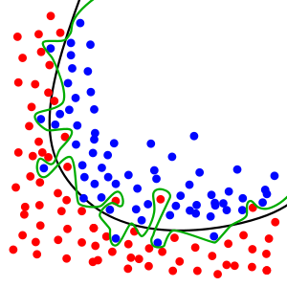
What does it mean to do a Cross Validation? How does it help to improve a model?
Model Evaluation Method
Helps to generalize model and build model’s resiliency towards outliers
Prevents significant LB shake-ups
Gives clearer indication whether model A performs better then model B
Three ways to perform CV
Hold-out: train/test set, typically 70/30 setup
K-fold CV: same as above but repeated over k-times leaving out 1 set as test, and k-1 set as training. Computational time is dependant on k-folds
Leave-one-out: Best CV, same as above but leaving out only one sample point and has to be repeated over n samples time. Most expensive CV but provides the best results from the averaged errors
Notes:
Remember CV as your bread and butter for any data science projects/experimentations. You need to validate your ML model. How do you know that your ML model is able to replicate its accuracy for new data points?
2 considerations here: Overfitting vs Too generalized model. Variance-bias trade-offs.
Hold-out (while it saves up computational time, only need to build the model once, and predict on the test set), need to consider the balance between train and test set. What if you have a response variable that contains 70% yes, 30% no and it happen coincidentally that in your train set, it contains majority of the yes, and test set contains majority of the no. Need to carefully select the samples between train/test. Caret package createDataPartition() helps to make sure that the response is balanced.
As you increase the number of K-folds, the model is able to capture the errors and averaged them by the n-folds and thus the model is more generalizable.

Slide 16
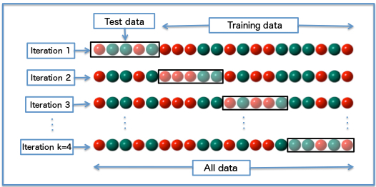


Hold out 25% samples
Train 75% samples
How to Set Up Cross Validation?
4 fold CV
3 fold CV

Slide 17
eXtreme Gradient Boosting: Key Considerations
Developed by Chen TianQi (University of Washington, Large Scale Machine Learning)
requires(xgboost)
Relatively easy to set up in R, challenging to set up in Python, especially on a window machine.
Multi-thread-able on R: nthread=n
Three boosters to choose from (gbtree, dart, gblinear)
Standard evaluation metrics (customizable)
Objectives (loss function customizable)
Full description/parameters of the model: https://github.com/dmlc/xgboost/blob/master/doc/parameter.md
Notes:
DART implementation is a new spin off initiatives from drop out in Neural Nets. Trees are drop out and rescaled in weights instead. Reference: https://arxiv.org/pdf/1505.01866.pdf

Slide 18
XGBOOST: Tuning Hyper Parameters
eta; default = 0.3
Learning rate of the loss function, aka step size shrinkage
Range [0 – 1]; 0.005 – 0.05 (0.005)
A lower learning rate should have higher nrounds
colsample_bytree; default = 1
Number of features to consider for building each tree
Range [0 – 1]; 0.15 – 0.85 (0.05)
subsample; default = 1
Random selection of samples for building model, 0.5 = 50%
Range [0 – 1]; 0.70 – 0.95 (0.05)
max_depth; default = 6
Maximum depth of a tree
Range [1 – ∞]; 4 – 20 (1)
Higher values will overfit, monitor CV validation, influence computational speed
scale_pos_weight; default = 1
Useful for unbalanced class (scaled accordingly to positive vs negative cases)
Should be scaled to the ratio of ∑(negative cases) / ∑(positive cases)
Notes:
Tuning colsample_bytree = 0.699 & 0.701 (taking the average of these results will jump 1000 in ranks)

Slide 19
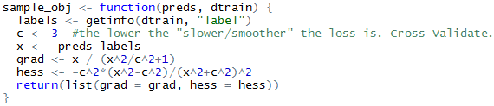
XGBOOST: Advance Tuning and Customizations
min_child_weight; default = 1
Minimum sum of instance weight (hessian gradient) in a child node, loss derivatives.
Range [0 – ∞]; 0 – 10 (1)
Higher values to be conservative, adjust accordingly with max_depth
gamma; default = 0
Minimum loss reduction to create a further partition leaf node. Pseudo regularization hyperparameter of gradient boosting (hyper sensitive to datasets).
Range [0 - ∞]; 0 – 20 (0.1, 0.01, 1)
Higher values will make the model more conservative. Mostly used for stacking/ensemble models.
eval_metric
Default metric assigned for respective objective, rmse for regression, auc for binary logistic, map for ranking.
Customized function takes in 2 input: “yhat” and “xgb.DMatix object”, where yhat = ground truth from train set and getinfo(dtrain, labels) = predicted.
objective
Input same as eval_metric (yhat & xgb.Dmatrix)
Needed output has to return a list(grad=grad, hess=hess)
Notes:
Min_child_weight:
- force pruning using derivatives, by hessian weights
Gamma:
- Pruning by the loss function, called “Lagrangian” multiplier (complexity control)
- useful when you have many highly correlated (identical ) strong predictive features in your model and it cannot be resolved by colsample_bytree. too strong feature engineering
- variance/bias tradeoff stabilize for a local optimum
Famous Kaggle thread for tuning hyper parameters of xgboost:
https://www.kaggle.com/c/santander-customer-satisfaction/forums/t/20662/overtuning-hyper-parameters-especially-re-xgboost?forumMessageId=118487

Slide 20
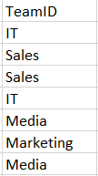
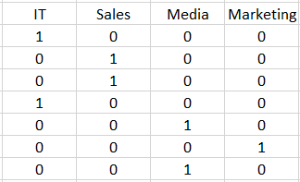
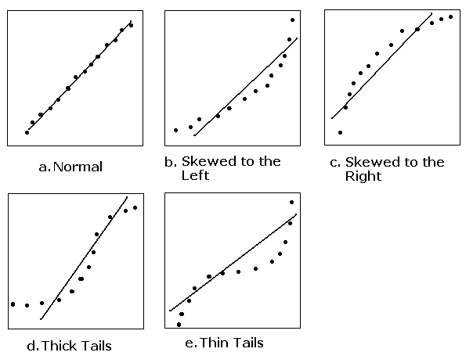
Features Engineering: Most Popular Picks
One Hot Encoding (Dummy Variables)
Typically used to transform categorical/nominal features. E.g. team ID (1=IT, 2=marketing, 3=sales, 4=media).
Log Scale Transformations
Ideal for continuous / numeric features with extremely large values. E.g. income ranges from 1,000 to 1,000,000 after log10() transformed will range between 3 to 6.
Z-Score Transformations
Ideal for continuous / numeric features with skewed distributions or flattened tail ends. QQ-plots.

Slide 21

Features Engineering: Most Popular Picks (Cont.)
Binarized Features
Ideally for converting continuous features into n bins.
Range of values that are highly correlated with response. E.g. age (13-99), response = spending power (e.g. house, luxury goods, etc..) age groups < 18 (low); 18 > age <= 25 (medium); 25 > age <= 40 (high); age > 40 (sub medium high).
“Categorized” bins and further One-Hot Encode it.
Pairwise Linear Features
Using any 2 features to create new feature.
Applicable for Categorical/Integer features (interaction term * or ratio is applicable). E.g. session time per article (ratio), article view by country (*). N (f1 nominal) x M (f2 nominal) of new features are created.
Higher Order Polynomial Features
Same as above, but using second, third, ….and higher order are used.
E.g. of a quadratic relationship with linear component: features a, b given y:

Slide 22
Ensemble Models
Different Models Definition
Different Seed
Combinations of different hyperparameters
Combinations of different features set
Algorithms (GLMNET, ENET, NNET, RF, XGBOOST, RLIGHTGBM and etc….)
Dark Art
Averaging on all submissions.
Rank averaging – sort all predictions for each model and rank them; distribute prediction scores according to their ranks.
Weighted averaging/ranking. Same as previous but assigning different weights on each/combination of models.
Random guess / based on modeler’s experience.
White Magic
Model based approach to ensemble. (requires at least 100 models, or 50% of dataset dimensions)
Predict train + test dataset
Model predictions are used as new features.
Blended approach – Using model predictions + original data features to build next stage predictions.
Stacking approach – Only use model predictions for next stage predictions.
Multi-stages (usually 3rd stage and 4th is a dark art averaging)
Notes:
No free hunch guide:
http://blog.kaggle.com/2016/12/27/a-kagglers-guide-to-model-stacking-in-practice/

Slide 23
R Code: Improving Your Submission on Getting a Decent Rank with XGB
DEMO
Notes:
Key takeaways:
With just a properly tuned model and a simple features engineering (binarized top features, and one-hot encoding) and a dark art ensemble, one can get a decent rank on Kaggle within 5 submissions in a day!
If you don’t want to waste your submissions in a day, use higher CVs at the expense of your computational resources.

Slide 24
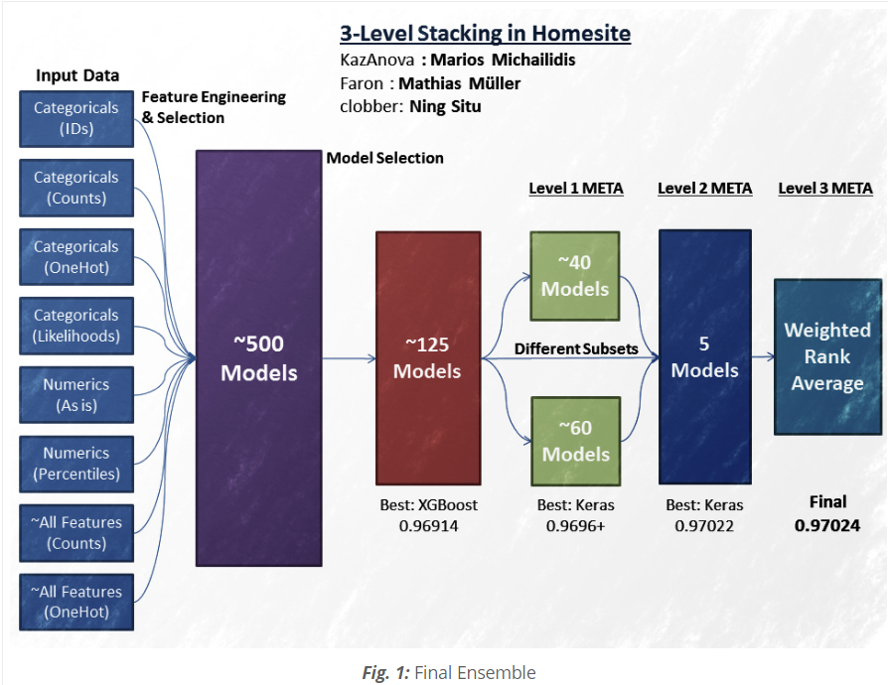
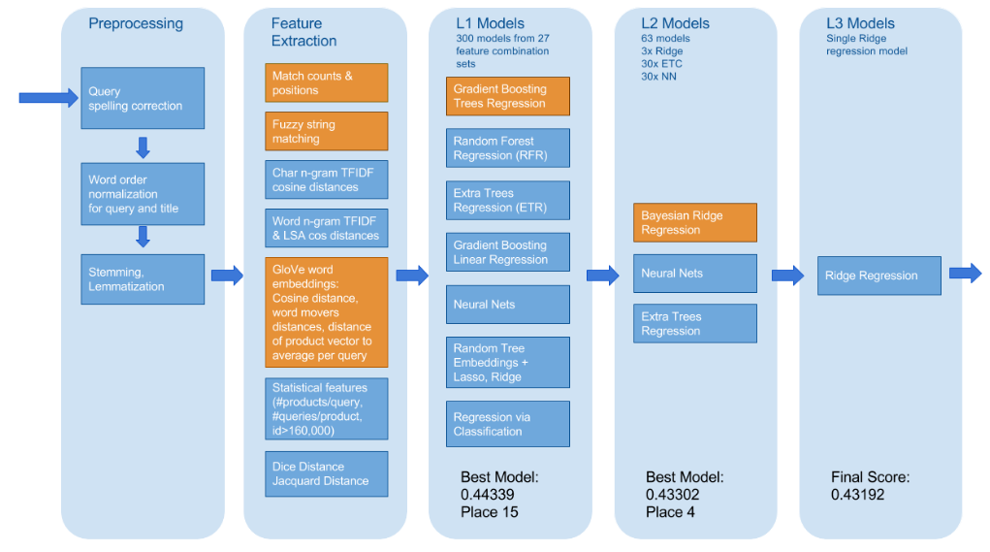
Kaggler Grandmasters Masterpiece
Home Depot Product Search Relevance
Alex, Andreas, Nurlan
http://blog.kaggle.com/2016/04/08/homesite-quote-conversion-winners-write-up-1st-place-kazanova-faron-clobber/
http://blog.kaggle.com/2016/05/18/home-depot-product-search-relevance-winners-interview-1st-place-alex-andreas-nurlan/
Notes:
Homesite Quote winner:
http://blog.kaggle.com/2016/04/08/homesite-quote-conversion-winners-write-up-1st-place-kazanova-faron-clobber/
Home Depot Kaggle winner solution write up:
http://blog.kaggle.com/2016/05/18/home-depot-product-search-relevance-winners-interview-1st-place-alex-andreas-nurlan/
Home Depot is a text mining based prediction challenge, where competitors are challenged to predict the relevance of a product search. (Multi-classification objective) but features contains textual information.
- Preprocessing to extract fetures from textual data. Usuals: word corrections (misspelt words or acronyms)- especially hard for Singlish, word lemmatization, and stemming
Extract features out from processed textual information (TFIDF, n-grams for characters or word, fuzzy string matchings, Jaccard or Dice distance) e.g. hammer vs sledge hammer, general-purpose cleaner, all purpose cleaner, all purpose sanitizer), LSA (Latent Semantic Analysis) of a sentence – relationships of words.
L1 stage – all different models
L2 stage – Bayesian Ridge Regression, Neural Nets and ExtraTrees
L3 stage just ridge regression

Slide 25
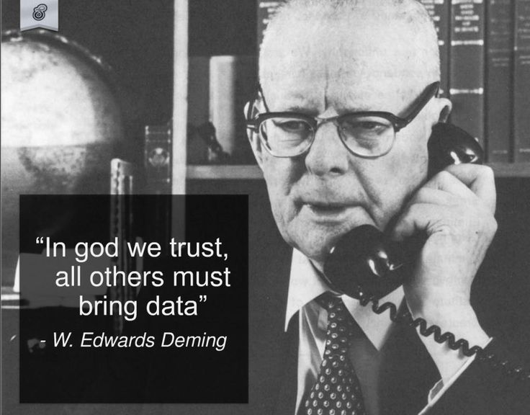
Notes:
Although I am a DS, but I believe that there is a God, and I would gladly put all my trust in my God to bless me with all good things/stuffs in my life.
In those times that I need to make a decision for myself (like for example, whether to invest in company or whether to change a career path), I need some data to help me with my decision like checking the company financial profile for the past few years,
Or checking the job market and salary mean from publicly available sources, like glassdoor and etc….

Slide 26
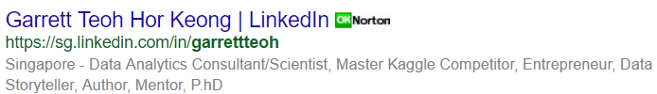
Thank You!
29th September 2017 DSI
Garrett Teoh
Notes:
Thank you for your attention and as I always tell my clients whenever I ran out of my namecards, check me out on google, it is my best name card!
If you wish to have a copy of the deck/materials, I will share the decks on my linkedin page.
Last but not least, a big shout out to organizers for providing an awesome auditorium and dinner for all of us.

